Slide 1


WEEK 3
SPRINT 1
PL6
QUA

Slide 2


about us.

Slide 3
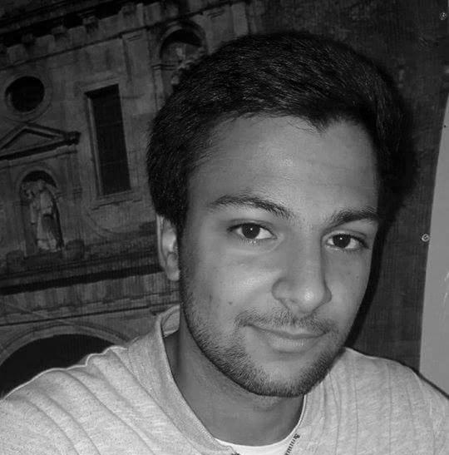
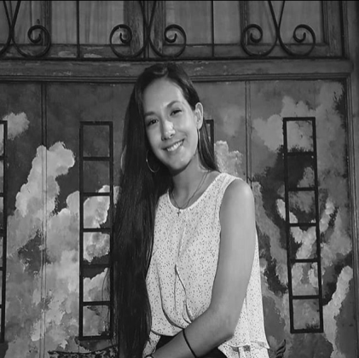
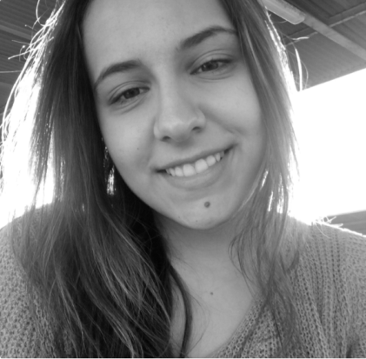
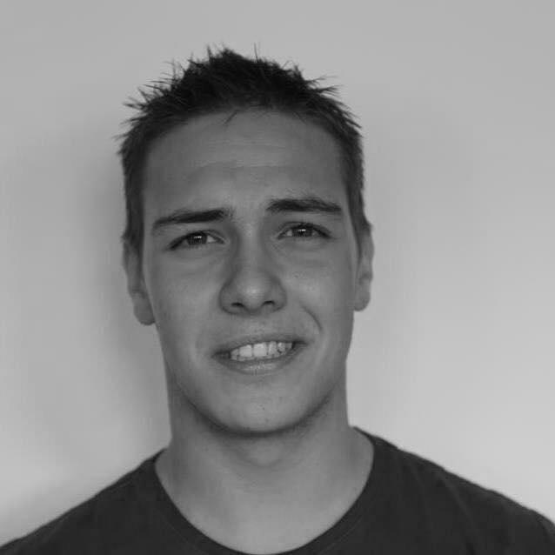
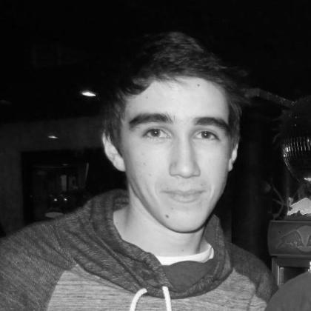
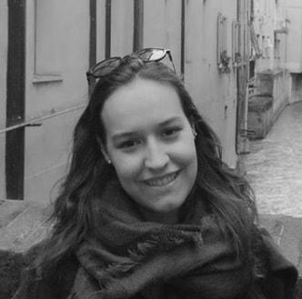
QUA
Hugo Marques
Viviana Abreu
Maria Alves
Luís Gonçalves
Rui Reis
Ana Almeida

Slide 4
tasks.
 | TASK #1 | TASK #2 | TASK #3 | TASK #4 | TASK #5 | TASK #6
TASK | Task delegation and group leadership | Elaboration of the meeting minutes | Status data gathering from the other units | Weekly presentation | Drafting of the Quality Manual | Organization of the tasks and presentation
OWNER | Hugo Marques | Maria Alves | Viviana Abreu | Hugo Marques | Full Group | Ana Almeida
GOAL EFFORT | 2 HOURS | 2 HOURS | 2 HOURS | 30 MINUTES | 4 HOURS (each) | 2 HOURS
STATUS | COMPLETED | COMPLETED | IN PROGRESS | ANNULED | IN PROGRESS | COMPLETED

Slide 5
planned tasks.
 | TASK #1 | TASK #2 | TASK #3 | TASK #4 | TASK #5 | TASK #6
TASK | Task delegation and group leadership | Elaboration of the meeting minutes | Status data gathering from the other units | Weekly presentation | Improvement of the Quality Manual | Organization of the tasks and presentation
OWNER | Hugo Marques | Maria Alves | Viviana Abreu | Hugo Marques | Full Group | Ana Almeida
GOAL EFFORT | 2 HOURS | 2 HOURS | 2 HOURS | 30 MINUTES | 4 HOURS (each) | 2 HOURS
STATUS | IN PROGRESS | IN PROGRESS | IN PROGRESS | IN PROGRESS | IN PROGRESS | IN PROGRESS

Slide 6
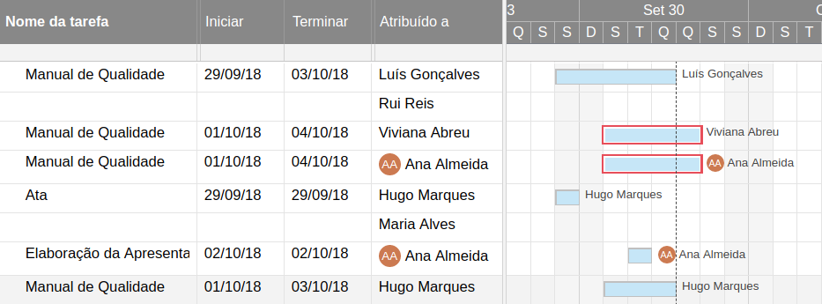
Gantt diagram.

Slide 7
additional notes.
Regarding the group work on the previous week, we can say that we communicated well within the unit and that we were readily available to work with the rest of team. When it came to weekly goals and tasks, we didn’t reach our goals, but still worked hard trying to complete the tasks. Besides that, the communication with the rest of the units is still lacking, not because of our lack of effort.

